Slide 1
Q+A

Slide 2
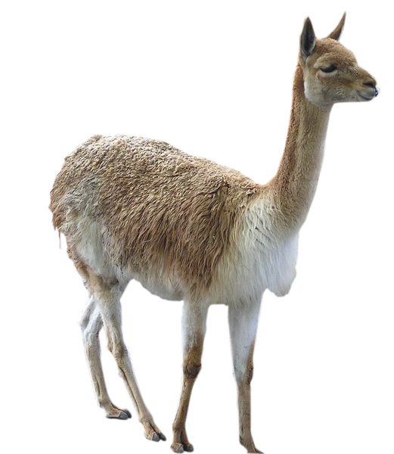
Q
A project to send llamas to Mars will take $100,000 and six months. Suddenly the budget is cut to $50,000. What are some possibilities?
a) Send llamas to the moon instead.
b) Send rats instead of llamas.
c) Work for twelve months.
d) Work for three months.

Slide 3
A
A project to send llamas to Mars will take $100,000 and six months. Suddenly the budget is cut to $50,000. What are some possibilities?
a) Send llamas to the moon instead.
b) Send rats instead of llamas.
c) Work for twelve months.
d) Work for three months.

Slide 4
Q
A project to build a big glass bubble over BVC will take 2 years and cost $1,500,000. Apparently SAIT wants a bubble too. What are some possibilities?
a) Say no.
b) Double the budget.
c) Double the time.
d) Just bubble SAIT and the south campus.

Slide 5
A
A project to build a big glass bubble over BVC will take 2 years and cost $1,500,000. Apparently SAIT wants a bubble too. What are some possibilities?
a) Say no.
b) Double the budget.
c) Double the time.
d) Just bubble SAIT and the south campus.

Slide 6
Q
Your team of five developers can build a new dating app in six months with $300,000. Your boss, who is single, wants it in three months. What could you do?
a) Ask for $600,000 and hire five more developers.
b) Remove three months' worth of features.
c) Eliminate all testing and quality measures.
d) Send your boss to Mars with the llamas.

Slide 7
A
Your team of five developers can build a new dating app in six months with $300,000. Your boss, who is single, wants it in three months. What could you do?
a) Ask for $600,000 and hire five more developers.
b) Remove three months' worth of features.
c) Eliminate all testing and quality measures.
d) Send your boss to Mars with the llamas.

Slide 8
Q
What do you think are benefits of having regular product increments to show a customer?
a) Frequent feedback on product direction.
b) Builds confidence and trust.
c) Highly visible progress.
d) Does not involve baby elephants.
e) Requires fewer developers.

Slide 9
A
What do you think are benefits of having regular product increments to show a customer?
a) Frequent feedback on product direction.
b) Builds confidence and trust.
c) Highly visible progress.
d) Does not involve baby elephants.
e) Requires fewer developers.

Slide 10
Q
Why do you think waterfall methodologies are less popular with software teams today?
a) Waterfall methodologies are inefficient.
b) Customers don't want to wait to see progress.
c) If the specifications are incorrect, the product will be too.
d) Computers and waterfalls don't go well together.
e) It's a big deal if requirements change.

Slide 11
A
Why do you think waterfall methodologies are less popular with software teams today?
a) Waterfall methodologies are inefficient.
b) Customers don't want to wait to see progress.
c) If the specifications are incorrect, the product will be too.
d) Computers and waterfalls don't go well together.
e) It's a big deal if requirements change.

Slide 12
Q
What do you think this chart represents?
Cost Of Remediation
Early In Project
Time
Late In Project

Slide 13
Q
What do you think this chart represents?
JARGON ALERT
Cost Of Remediation
Early In Project
Time
Late In Project

Slide 14

remediation (n) [ ri-mee-dee-ey-shuh n ]
The correction of something bad or defective; the action of applying a remedy to something.
dictionary.com

Slide 15
A
The cost of fixing a defect increases the later it is discovered.
Defects found here are relatively inexpensive to fix.
Defects found here are relatively costly to fix.
Cost Of Remediation
Early In Project
Time
Late In Project

Slide 16


